Slide 1
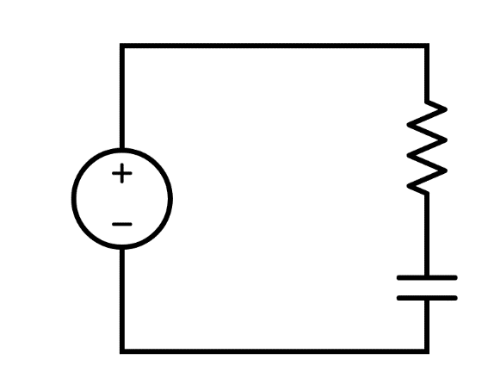





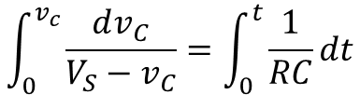



Deriving the RC Circuit Model
$$V_{S}=RC\frac{dv_{C}}{dt}+v_{C}$$
R
$$\frac{dv_{C}}{dt}=\frac{V_{S}−v_{C}}{RC}$$
V_{S}
C
$$\frac{dv_{C}}{V_{S}−v_{C}}=\frac{1}{RC}dt$$
$$V_{s}=v_{R}+v_{C}$$
KVL
$$\int_{0}^{v_{c}}{\frac{dv_{C}}{V_{S}−v_{C}}}=\int_{0}^{t}{\frac{1}{RC}dt}$$
$$v_{R}=i_{R}R$$
Ohm's Law
$$i_{R}=i_{C}$$
KCL
$$\ln\left(V_{S}−v_{C}\right)−\ln\left(V_{S}\right)=\frac{−t}{RC}$$
$$i_{C}=C\frac{dv_{C}}{dt}$$
Capacitive Current

Slide 2
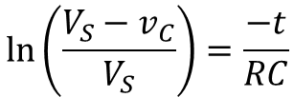

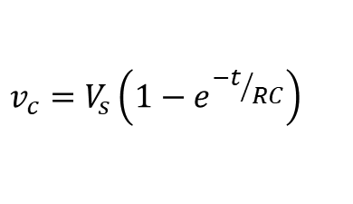

Deriving the RC Circuit Model
$$\ln\left(V_{S}−v_{C}\right)−\ln\left(V_{S}\right)=\frac{−t}{RC}$$
R
V_{S}
$$\ln\left(\frac{V_{S}−v_{C}}{V_{S}}\right)=\frac{−t}{RC}$$
C
KVL
$$\frac{V_{S}−v_{C}}{V_{S}}=e^{{−t}/{RC}}$$
$$V_{s}=v_{R}+v_{C}$$
$$v_{R}=i_{R}R$$
Ohm's Law
$$i_{R}=i_{C}$$
KCL
$$v_{c}=V_{s}\left(1−e^{{−t}/{RC}}\right)$$
$$i_{C}=C\frac{dv_{C}}{dt}$$
Capacitive Current
Voltage across the capacitor as a function of time

Slide 3
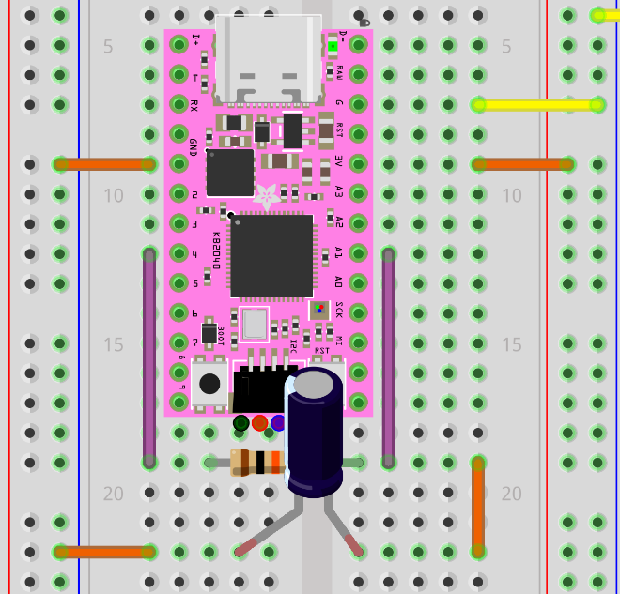

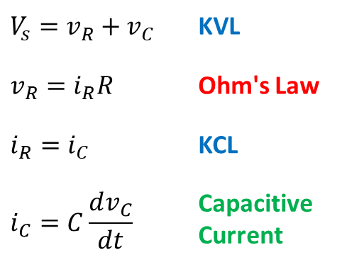


The rc_decay Circuit
Pin D4 → DAC mode
Pin A1 → ADC mode
We are measuring via an ADC the
voltage drop across the resistor
+3.3V
10KΩ
D4
A1
A1
GND
10$μ$F

Slide 4
Big Picture of rc_decay Lab
code.py running on KB2040
rc_decay.py running on Laptop
Waits for a serial (USB) port connection from the laptop
Connects to the KB2040 over the serial (USB) port
NeoPixel is GREEN
Waits for the command "r" to be sent by the laptop over the USB (CDC Data) port
Sends the string "r" to the KB2040 over the CDC Data port
Waits to receive the volts and times from the KB2040
Sets NeoPixel to BLUE to fully discharge capacitor, then to RED as it recharges the circuit while measuring volts & times
Plots the voltage vs. time graph for the RC circuit and saves a PNG file of the plot window
Sets NeoPixel to YELLOW as it sends the volts and times to the laptop over the USB port

Slide 5
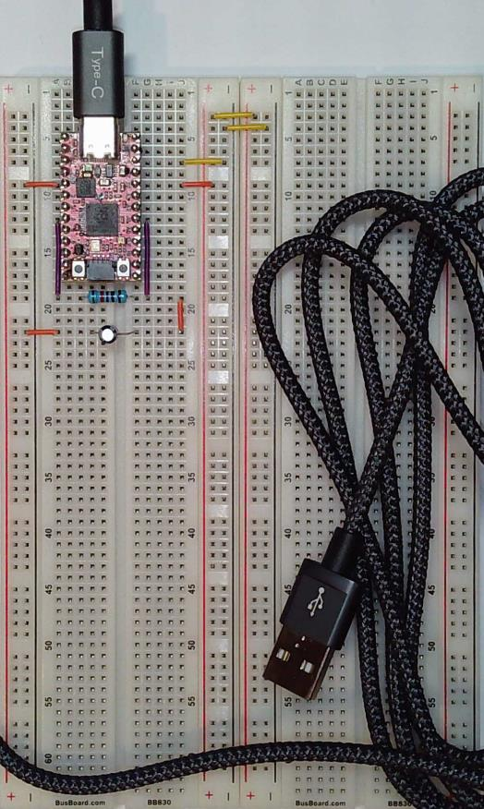
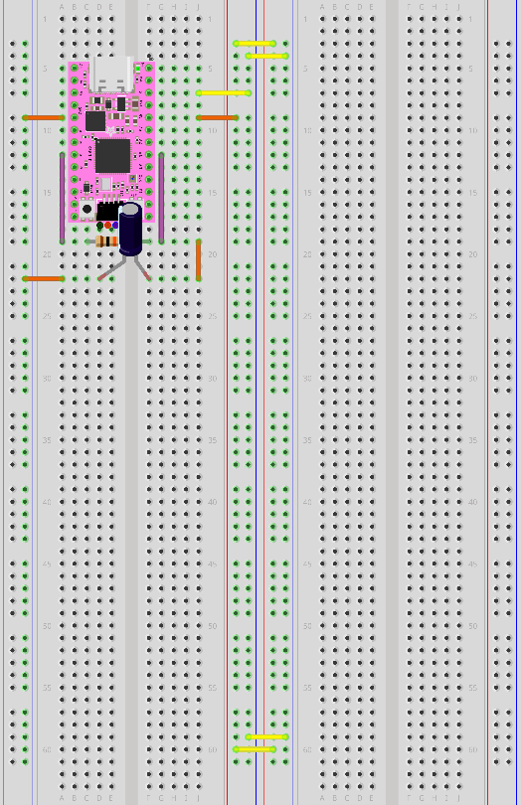
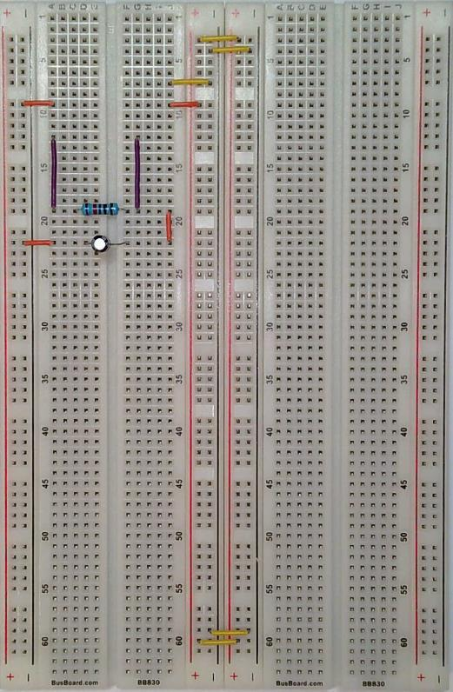
Step 05 – KB2040
(1) KB2040
(1) USB Cable
GND
+3.3V

Slide 6
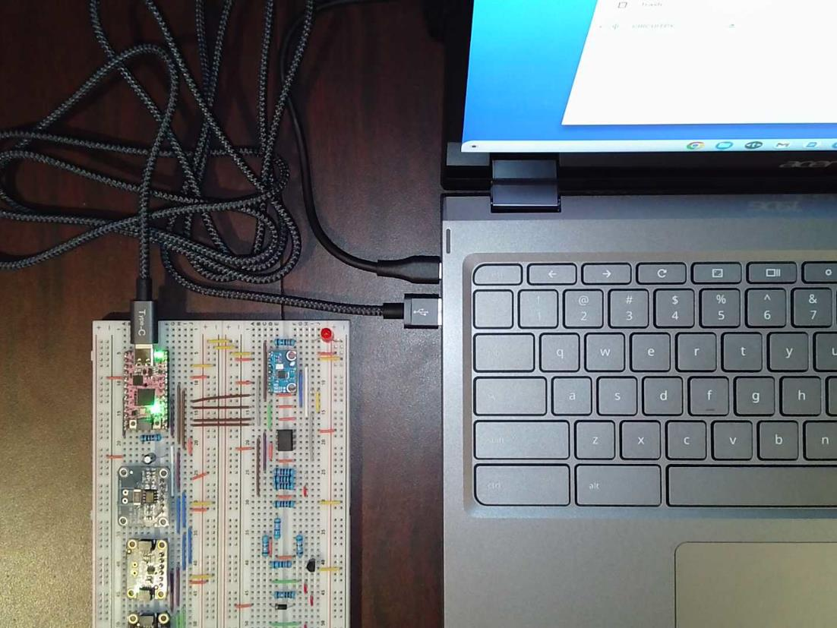
Connect the KB2040

Slide 7
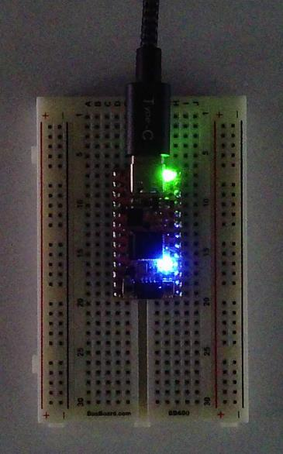
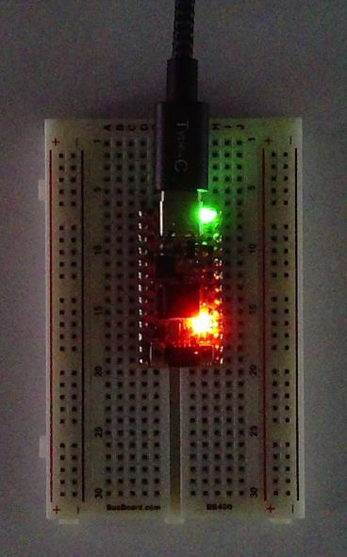
The DAQ device is working…
Discharging
before starting
Measuring circuit voltage over time

Slide 8
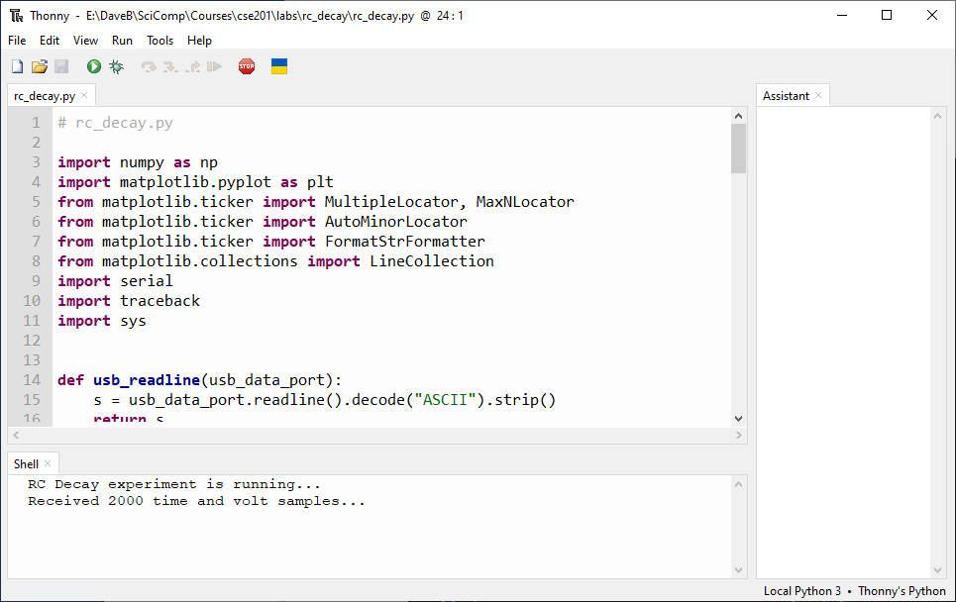
Run rc_decay.py

Slide 9
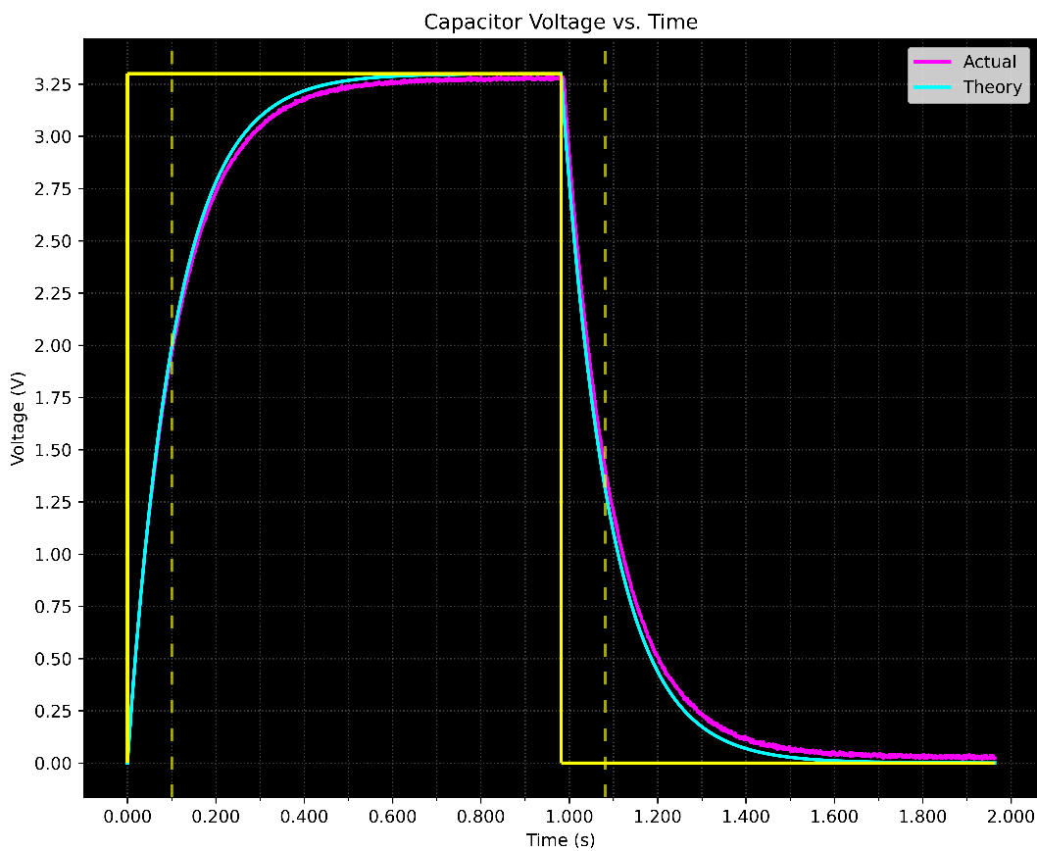
Check rc_decay.py

Slide 10
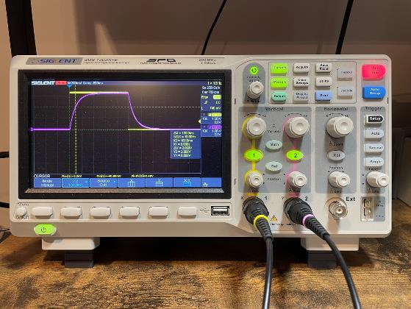
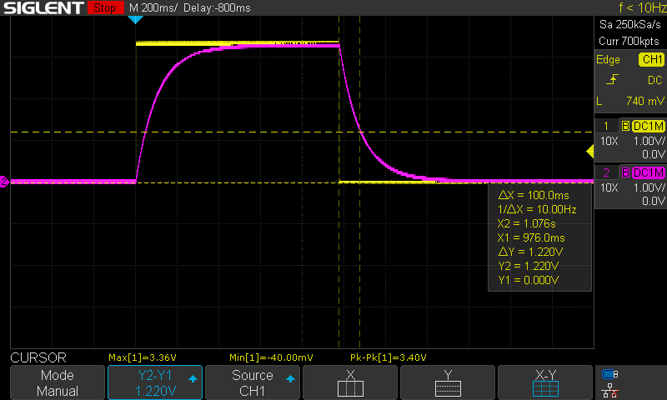
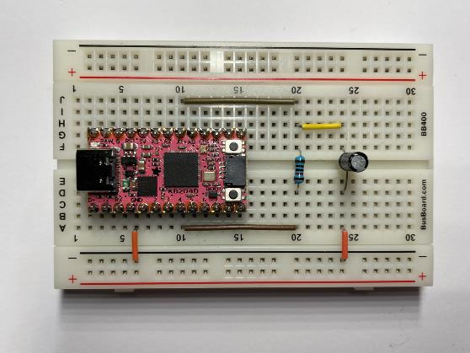
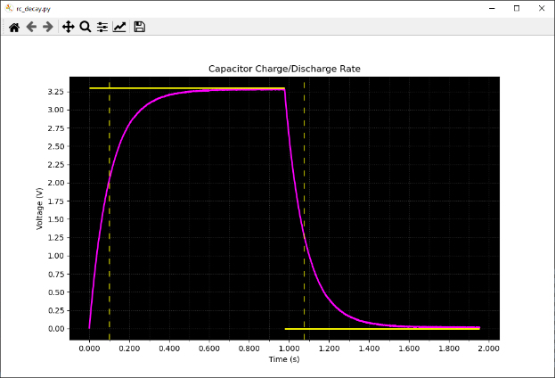


$$\$450 Oscilloscope$$
$$\$10 Computer$$

